Slide 1


Project Stage II PROJECT TITLE :- “Weapon Detection and Person Tracking” GUIDE NAME: Prof. Nita Dimble
Navashyadri Groups of Institute Faculty of Engineering
ACADEMIC YEAR 2024-25
DEPARTMENT OF AI & ML ENGINEERING

Slide 2
GROUP MEMBER :-
Roll No. | PRN No. | Name
1 | 72214630C | Pratik Kamble
2 | 72214611G | Aditya Jadhav
3 | 72214622B | Monali Jamdade
4 | 72214558B | Gayatri Bagal

Slide 3
CONTENTS :-
PROBLEM STATEMENT
LITERATURE REVIEW
OBJECTIVES
METHODOLOGY
BLOCK DIAGRAM
RESULT
7. ADVANTAGES
8. APPLICATIONS
FUTURE SCOPE
REFERENCES

Slide 4
1. PROBLEM STATEMENT:-
To develop a Weapon Detection and Person Tracking System utilizing YOLOv8 for accurate object identification and DeepSORT for tracking multiple objects. The work of the system is to reliably identify weapons, monitor the individual carrying them throughout the frames, and enhance surveillance effectiveness for improved public safety.

Slide 5
2. LITERATURE REVIEW:-
NO. | PROJECT TITLE | LITERATURE REVIEW
2.1 | “Object detection using YOLO: challenges, architectural successors, datasets and applications” ,Tausif Diwan1 & G. Anirudh2 & Jitendra V. Tembhurne | This paper provides a comprehensive overview of object detection, with an emphasis on the challenges and advancements in YOLO (You Only Look Once) models. It discusses how YOLO and its successors have become prominent in applications requiring fast inference timesespecially for smaller objects​
2.2 | Wojke, N., Bewley, A., & Paulus, D., "Simple Online and Realtime Tracking with a Deep Association Metric," IEEE International Conference on Image Processing (ICIP), 2017. | It introduces the YOLO (You Only Look Once) framework, which revolutionizes object detection by treating it as a single regression problem, enabling fast and accurate real-time detection. This approach significantly improves processing speed while maintaining high accuracy, making it a foundational work in the field of computer vision and object detection.
2.3 | "StrongSORT: Make DeepSORT Great Again" Yunhao Du, Zhicheng Zhao, Yang Song | Paper enhances DeepSORT by improving feature extraction, motion modeling, and addressing missed associations, leading to more accurate and robust multi-object tracking.

Slide 6
3. OBJECTIVES :-
Detect weapons in real-time from live video feeds with high accuracy.
Track and identify individuals across multiple frames, even with occlusions.
Improve model efficiency for faster detection and smoother tracking.
Enhance public safety by providing automated surveillance support.

Slide 7
4. METHODOLOGY
1. Data Collection
We collected a dataset of images containing weapons and non-weapons. The dataset was structured into two main directories: train and validation, each containing subdirectories for weapons. This structure allowed us to effectively utilize data for training and evaluation.
2. Model Selection
YOLOv8 (You Only Look Once v8) for real-time object detection due to its speed and accuracy. Trained/used a pre-trained model for detecting weapons and humans.
DeepSORT (Simple Online and Realtime Tracking) for multi-object tracking, which assigns unique IDs to track individuals across frames.
3. System Workflow
Input video is processed frame-by-frame.
YOLOv8 detects weapons and people, generating bounding boxes and class labels.
DeepSORT uses Kalman Filters and a re-identification model to track people by assigning unique IDs.
Outputs real-time tracking with labels for detected weapons and individuals.

Slide 8
4. Implementation tools
Frameworks: Python, OpenCV, PyTorch.
Libraries: Ultralytics YOLOv8, DeepSORT.
Hardware: Tested on GPU (mention specifications if applicable) for faster inference.
5. Conclusion
Through this methodology, we successfully built and validated a weapon detection model using ML, also we have get pose estimission as well as and also we have achieved person tracking via DeepSORT. Demonstrating promising results that highlight the potential of deep learning in real-time security applications.

Slide 9
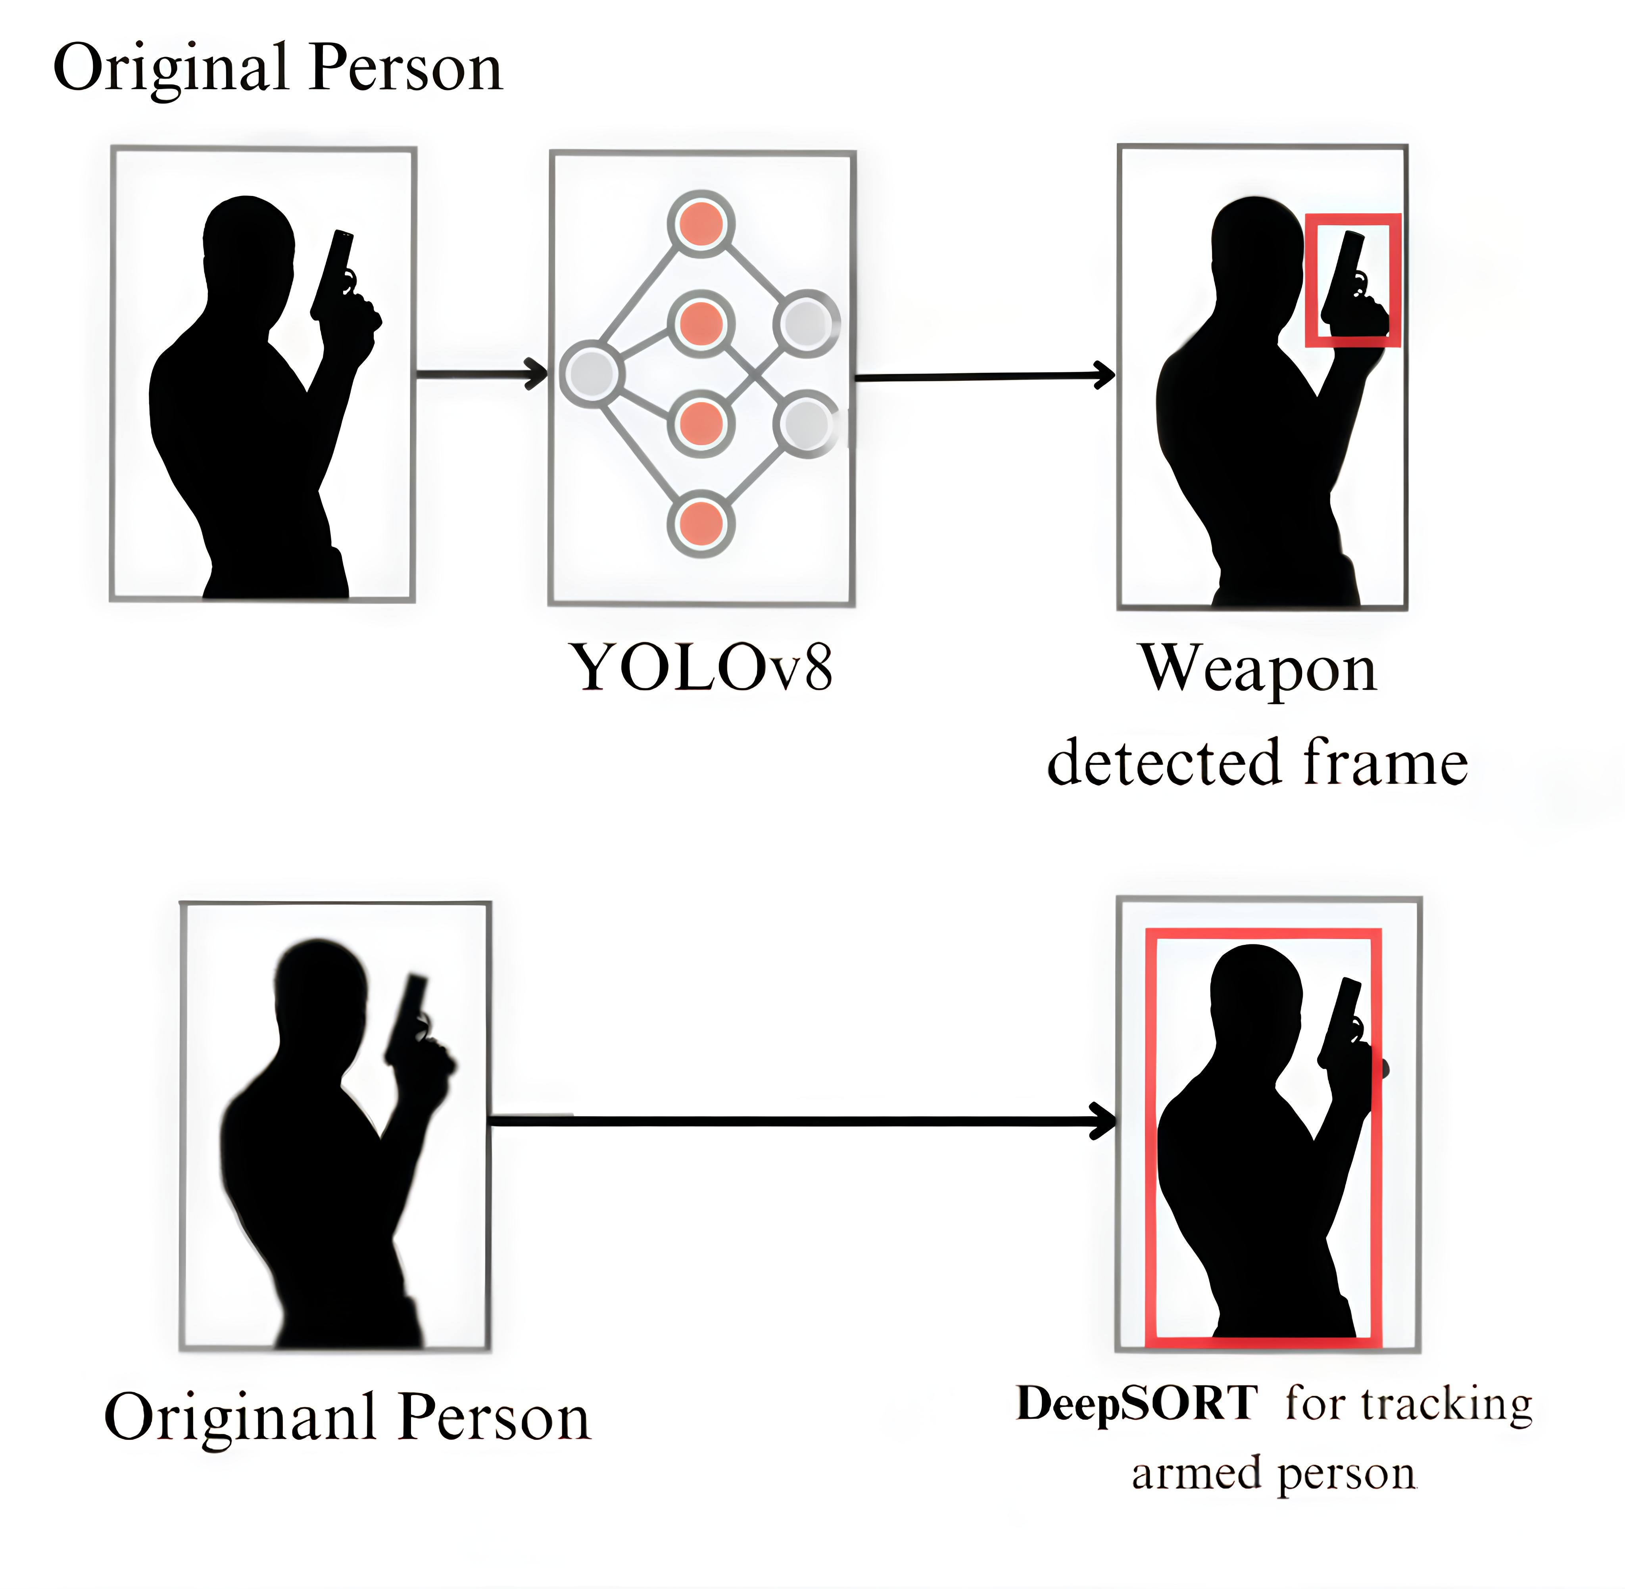
5. BLOCK DIAGRAM :-

Slide 10
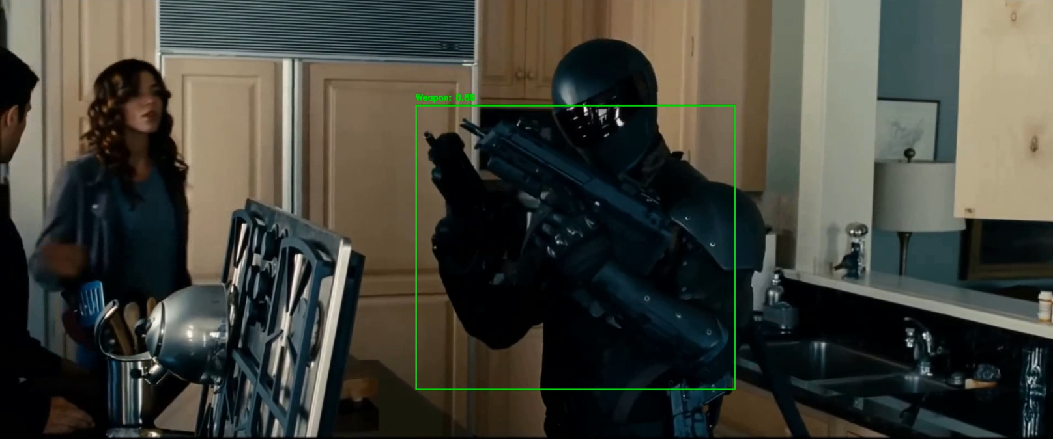
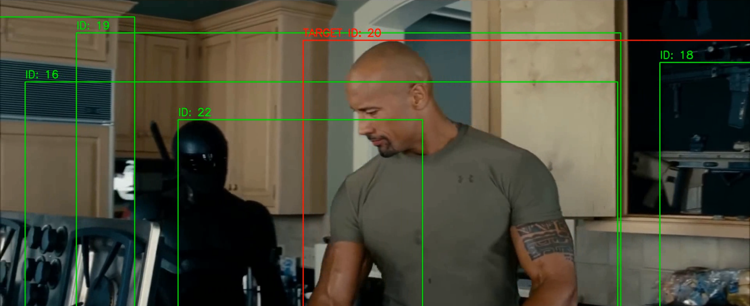
6. Result:-
Weapon Detection Result :-
Person Tracking :-

Slide 11
7. ADVANTAGE:-
Improved Public Safety
Cost-Effective Surveillance Automation
Multi-Object Tracking Capability
Tracking for Criminal Activity
Non-Intrusive Monitoring

Slide 12
8. APPLICATION :-
1. Airports and Transportation Hubs
2. Sports Stadiums and Large Public Venues
3. Hospitals and Healthcare Facilities
4. Corporate Campuses and Offices

Slide 13
9. FUTURE SCOPE:-
Integration with Smart Cities
AI and Deep Learning Advancements
Privacy-Respecting Security Systems
Use in High-Risk Environments (e.g., Conflict Zones, Disaster Areas)

Slide 14
10. References:-
1] Object detection using YOLO: challenges, architecturalsuccessors, datasets and applicationsTausif Diwan1 & G. Anirudh2 & Jitendra V. Tembhurne
2] Weapon Detection in Real-Time CCTV Videos Using Deep Learning MUHAMMAD TAHIR BHATTI 1 , MUHAMMAD GUFRAN KHAN 1 , (Senior Member, IEEE), MASOOD ASLAM 2 , AND MUHAMMAD JUNAID FIAZ1
3] Wojke, N., Bewley, A., & Paulus, D., "Simple Online and Realtime Tracking with a Deep Association Metric," IEEE International Conference on Image Processing (ICIP), 2017.
4] StrongSORT: Make DeepSORT Great Again Yunhao Du, Zhicheng Zhao, Yang Song Yanyun Zhao, Fei Su, Tao Gong, Hongying Meng, 2016.
5] OpenVINO Deep Learning Workbench: Towards Analytical Platform for Neural Networks Inference Optimization To cite this article: Alexander Demidovskij et al 2021 J. Phys.: Conf. Ser. 1828 012012

Slide 15
THANK YOU…

